Slide 1


Slide 2


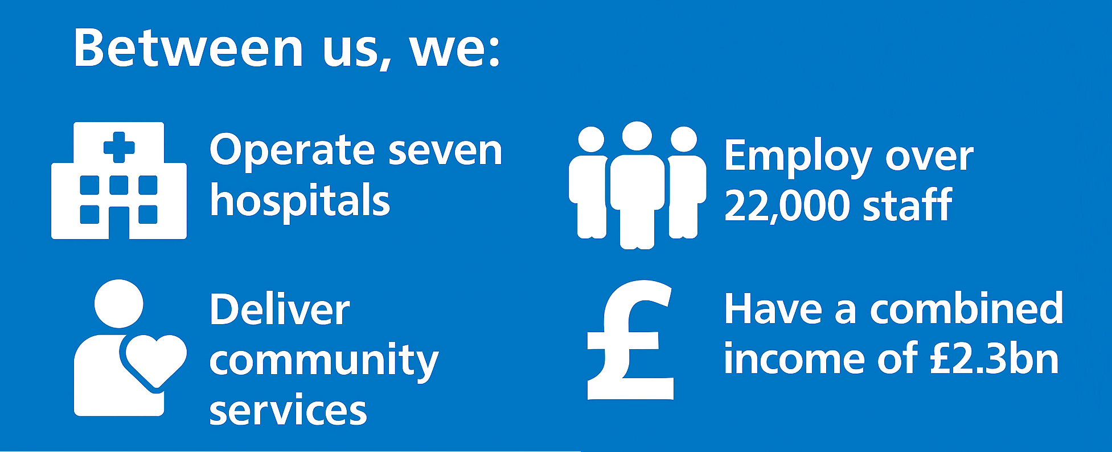
Liverpool’s adult acute and specialist hospital services have historically been delivered by multiple NHS trusts.
In July 2024, five trusts formed the Liverpool Adult Acute and Specialist Providers (LAASP) partnership, with three operating under shared leadership as the University Hospitals of Liverpool (UHL) Group: Liverpool University Hospitals, Liverpool Women’s and Liverpool Heart and Chest, alongside Clatterbridge Cancer Centre and The Walton Centre.
This five-year strategy sets out how closer collaboration will improve patient care, efficiency and outcomes by 2030.

Slide 3

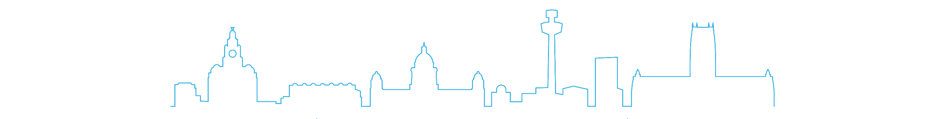
The population of Liverpool is over 500,000 people. Together Liverpool, Sefton and Knowsley
- North Mersey - have a population of around 950,000 people.
Through our specialist and tertiary services, we serve a population of well over 3 million people across Cheshire and Merseyside, parts of Lancashire, North Wales and the Isle of Man.
The communities we serve live shorter lives compared to the national average, with rising numbers of people living with long term health conditions.
Many people spend years living with poor health, a lot of which could be prevented. Waiting times can be long and services are not always joined up.
Our strategy has been developed using population health data and aligns with the NHS 10-Year Health Plan, supporting shifts from hospital to community, analogue to digital, and sickness to prevention.

Slide 4

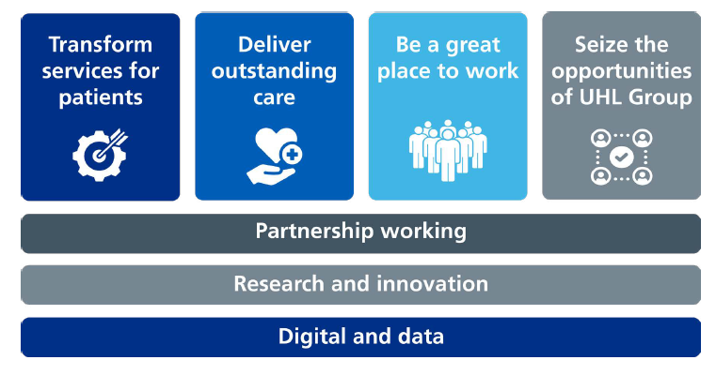
The Group’s purpose is to deliver excellent healthcare that improves lives, with the ambition to become a leading healthcare group nationally and globally.
Our strategy sets out four objectives and three enablers which underpin delivery:

Slide 5
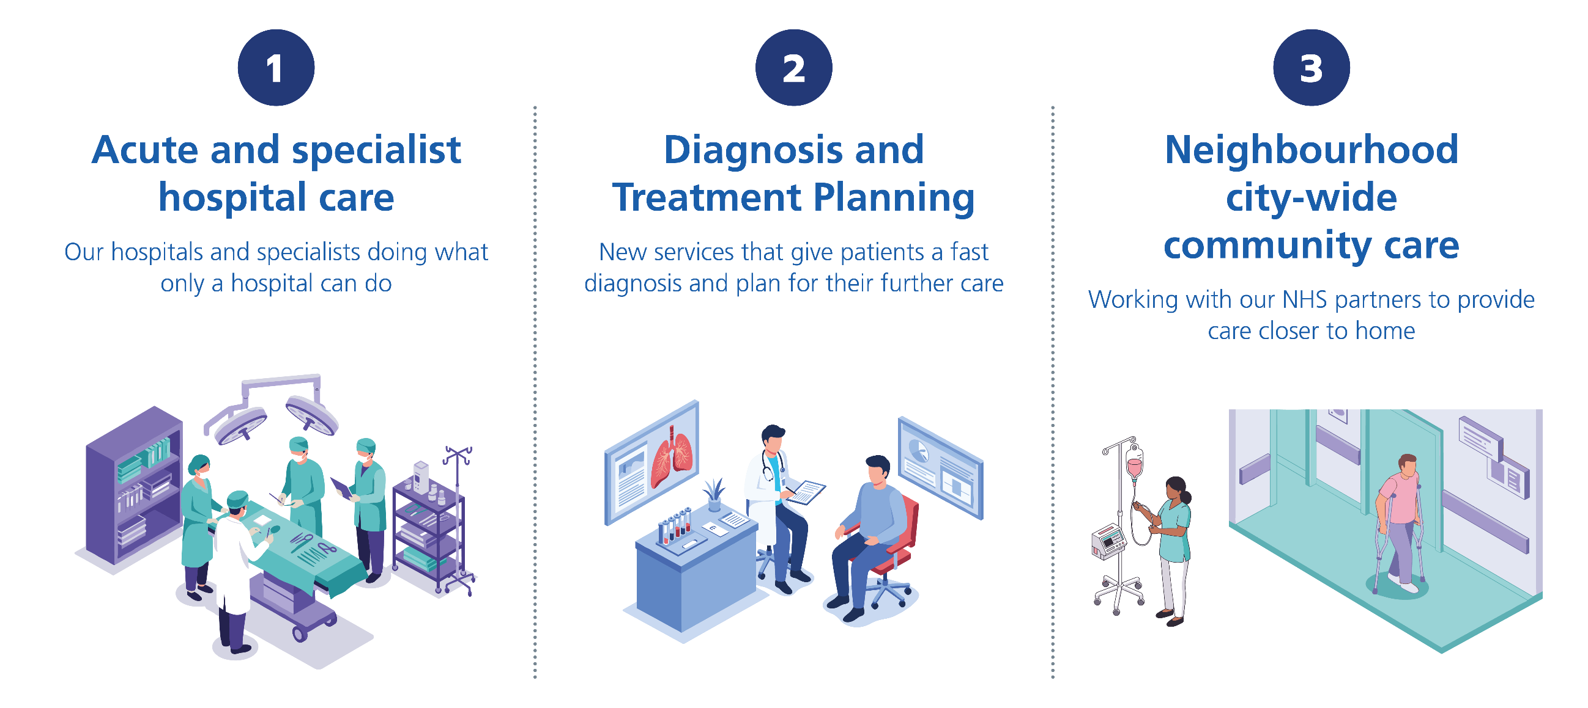
Services will be redesigned around three care models:

Slide 6
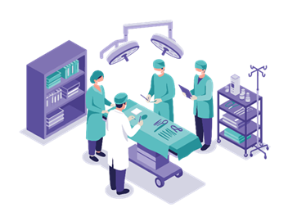
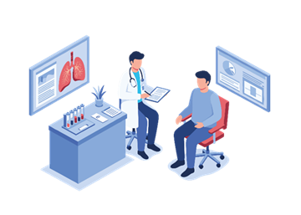
1. Acute and specialist hospital care
We will work with partners to reduce the demand on our hospitals by doing more in the community and start to develop a smaller, more focused adult acute and specialist hospital system in Liverpool. This will deliver an improved experience and better outcomes for our patients.
2. Neighbourhood and community care
We need to embrace new and innovative models of preventative and proactive community care, to give patients access to the care they need close to their homes. This will also support hospitals by reducing demand on services and helping maintain patient flow by supporting patient discharge.

Slide 7
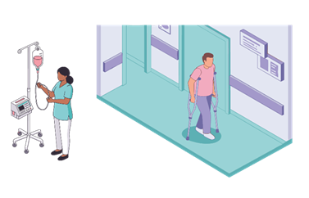
3. Diagnostic and treatment planning There is an opportunity to improve services for patients by looking beyond the traditional outpatient model of care. Through our diagnosis and treatment planning care model, we will work to speed up our existing pathways and make better use of existing alternatives to outpatient appointments, like specialist ‘advice and guidance’ services for GPs and direct access for GPs to diagnostic tests.
We will also work with clinical teams to develop new and innovative pathways and services that result in a rapid diagnosis and recommendations for future treatment, outside of hospital where appropriate.

Slide 8
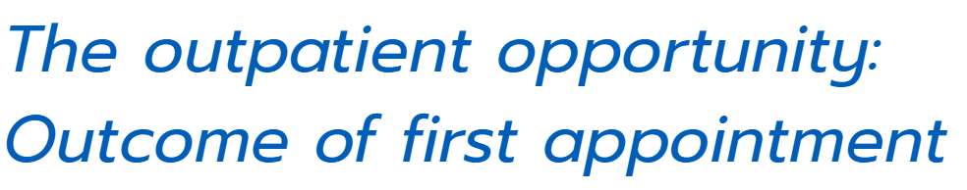
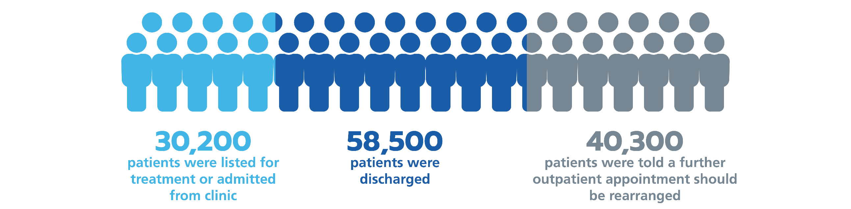
We looked at the recorded outcomes of the nearly 134,000 first outpatient appointments at Liverpool University Hospitals in 2024/25.
The high proportion of patients discharged after one appointment or listed for an additional outpatient appointment suggests an opportunity to fundamentally review the outpatient model to improve our services for patients.

Slide 9


The Group will embed a consistent quality management system, meet NHS constitutional standards, and improve operational and financial performance.
Safe – minimising the harm from care that is intended to help
Timely – intervening early to prevent illness and avoiding waits and potentially harmful delays
Effective – providing only services that are proven to work
Efficient – making best use of clinical and other resources and avoiding waste
Equitable – providing care that is fair and does not vary between groups
Person-centred – providing care for patients that is respectful and responsive and a workplace that is supportive
Sustainable – considering the needs of the wider population and the patients of the future, as well as the patients of today.

Slide 10
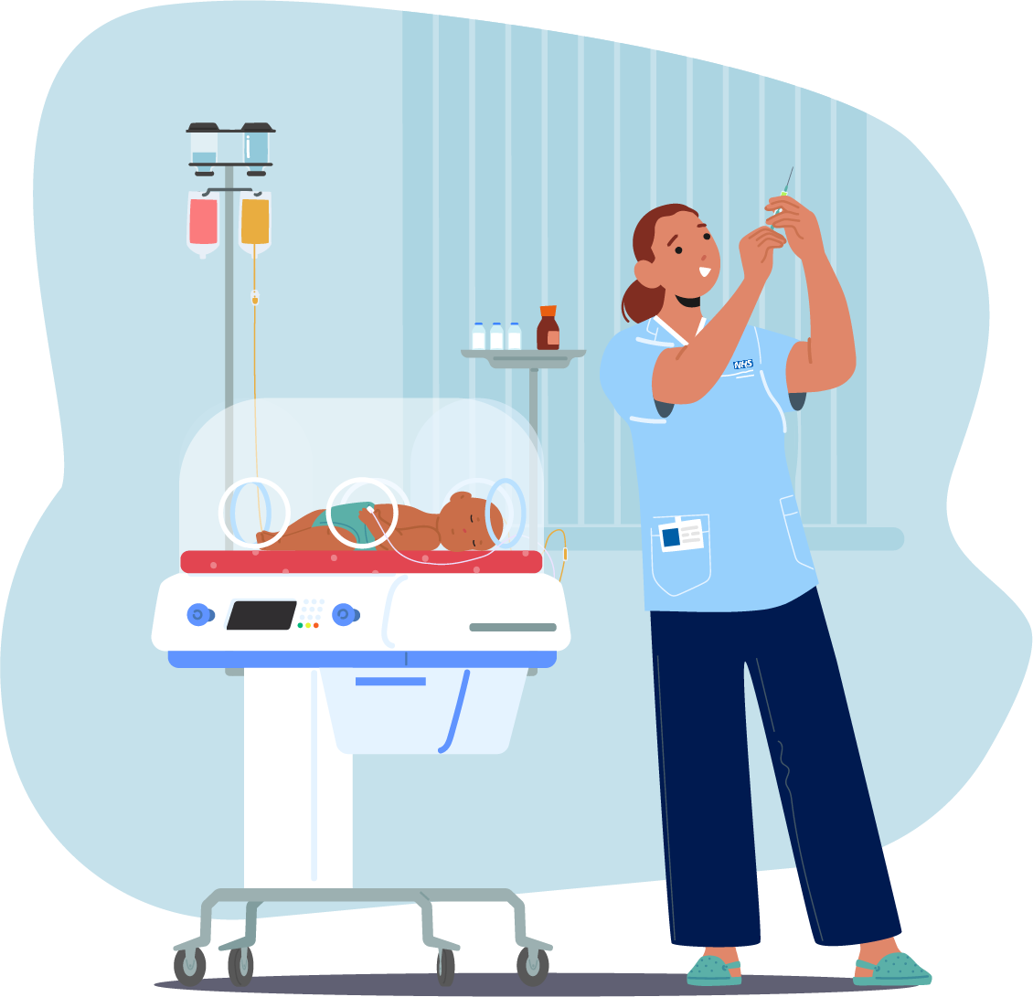
UHL Group is one of the biggest employers in the region and every single member of staff contributes to the patient care that we are able to deliver.
We want to attract, develop, and retain staff through inclusive culture, leadership development, flexible careers, and workforce wellbeing, while acting as a major regional employer and anchor institution.
We need to grow and develop our workforce in response to a changing world. Three key themes that will alter the shape of our workforce over the next five years:
Our three care models – our workforce will need to change to deliver the transformation in our clinical services.
Generational changes in the labour market – we will need to adapt to generational changes in the needs and expectations of the workforce.
The advent of artificial intelligence and automation – the impact on our workforce will be significant, with the potential to liberate clinical staff from admin, freeing up time to care, and increase productivity in other services.
We will develop people plans that address these three themes and support our staff and services to navigate through this changing landscape.

Slide 11

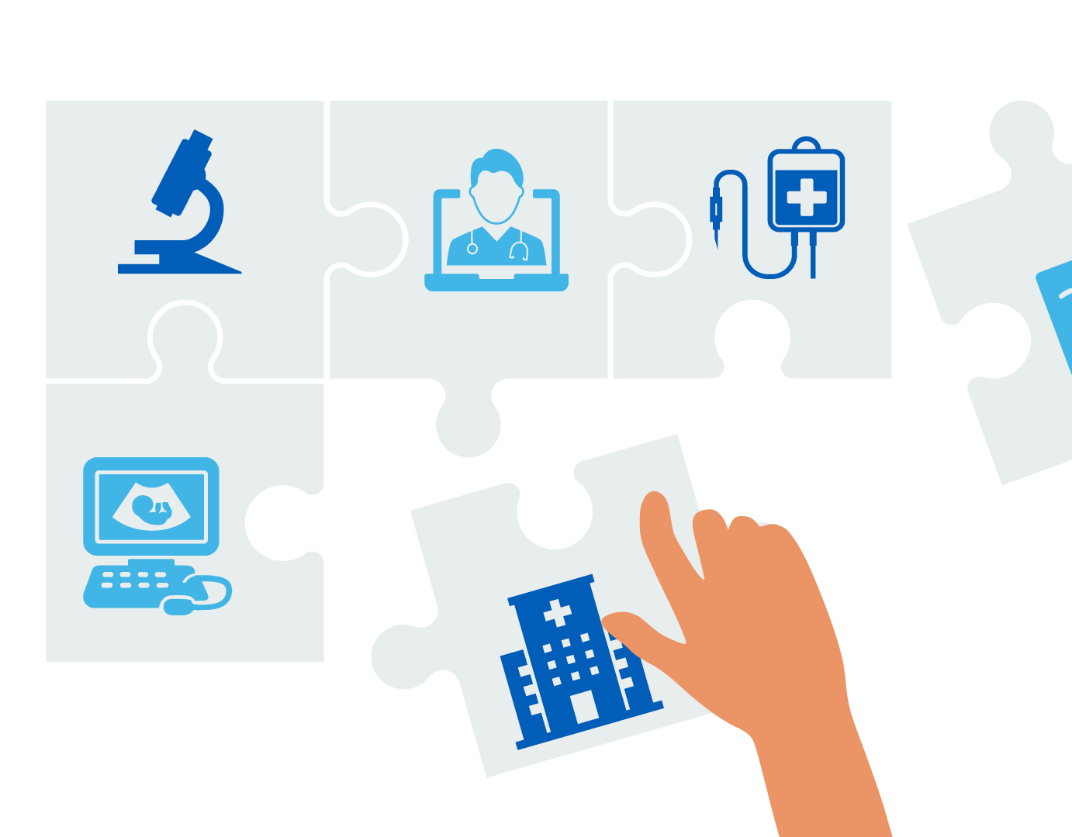
Closer integration will increase efficiency, improve use of shared estates, expand commercial opportunities, reduce environmental impact, and strengthen social value for local communities.
To be able to achieve the four objectives set out in our strategy we will need a real focus on three key enablers:
Partnership working - strong collaboration across NHS partners, local authorities, universities, and industry is essential to deliver community care, research, and service transformation.
Research and innovation - R&I will be embedded in daily practice, increasing access to trials, strengthening academic leadership, and supporting economic growth while improving patient outcomes.
Digital and data - a single Electronic Patient Record, shared digital infrastructure, AI-enabled pathways, and a robust data strategy will support safer, more efficient, and more personalised care.

Slide 12

This strategy has been developed through extensive engagement with colleagues, patient and public representatives, and with our partners in the NHS and beyond.
It sets out what we want to achieve over the coming years, but we need to translate the high-level ambitions into detailed plans for action in each of our hospitals, clinical services and corporate and support areas.
Every member of staff will have a role to play in the delivery of this strategy. We will put in place plans to ensure that our people and teams have the capabilities, tools and support that they need to bring about the change that is required.
Our communications and engagement plans will ensure that the strategy provides a consistent thread to our work over the next five years. We will put in place regular reporting on our progress to the UHL Group and LAASP Boards of Directors, Governors and staff. This will ensure that we can be held to account for the delivery of the commitments we have made in this strategy.

